Slide 1
Social Media Analysis

Slide 2
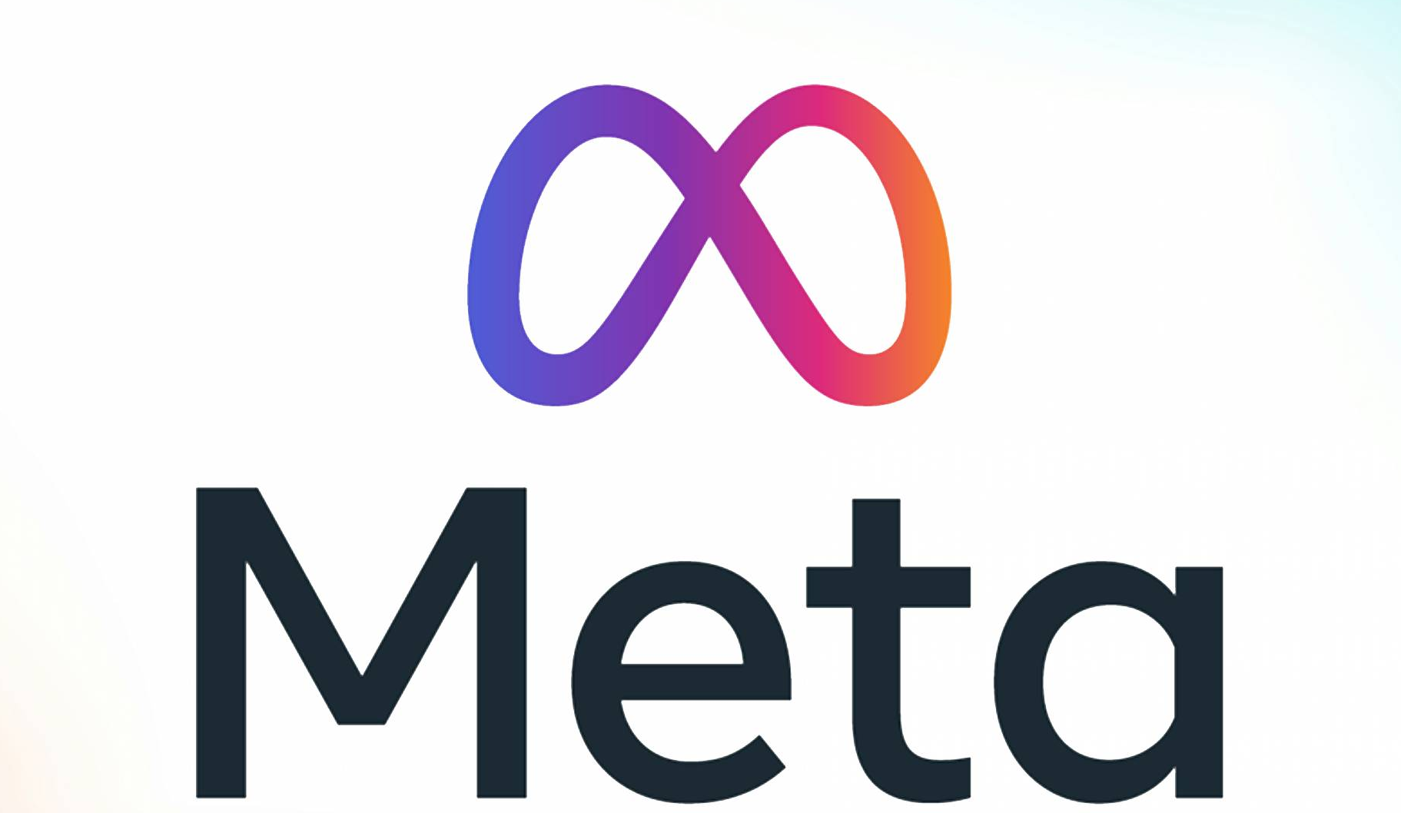
Meta owns the world’s largest VR social platform — Horizon Worlds.
This is part of Meta’s broader mission to build the metaverse, a virtual shared space where people can interact, work, and play using virtual and augmented reality. CEO Mark Zuckerberg has committed billions of dollars to this vision, even renaming the company from Facebook to Meta in 2021 to reflect this shift.

Slide 3
Problem Statements
How can we identify and leverage key user behavior patterns (e.g., photo uploads, content engagement, and feature usage) to drive higher user engagement on Instagram?
What differentiates retained users from churned users, and how can targeted interventions (e.g., personalization, incentives, notifications) be used to reduce churn and increase retention?

Slide 4
Data Description
Instagram User Interaction Dataset Overview
This dataset captures various aspects of user behavior and interactions on the Instagram platform, providing a
comprehensive foundation for analyzing engagement, content trends, and user relationships.
Data Attributes Explained:
comment_id: Unique identifier for each comment posted.
comment_text: Textual content of the comment left by a user.
user_id: Unique identifier assigned to each Instagram user.
photo_id: Unique identifier associated with each photo shared.
created_at: Timestamp capturing when an interaction (like, comment, photo upload, tag) occurred.
follower_id: user_id of a user who follows another user (follower).
followee_id: user_id of a user who is being followed (followee).
tag_id: Unique identifier for tags used on photos.
image_url: Direct link to the uploaded image on the platform.
username: The unique handle or display name chosen by the user.

Slide 5
Data Overview
Total Registered Users: 100
Total Posts Created: 257
Total Tags Used: 21
Total Likes Received: 8,782
Total Comments Made: 7,488
Tags:
beach, beauty, concert, delicious, dreamy, drunk, fashion, food, foodie, fun, hair, happy, landscape, lol, party, photography, smile, stunning, style, sunrise, sunset

Slide 6
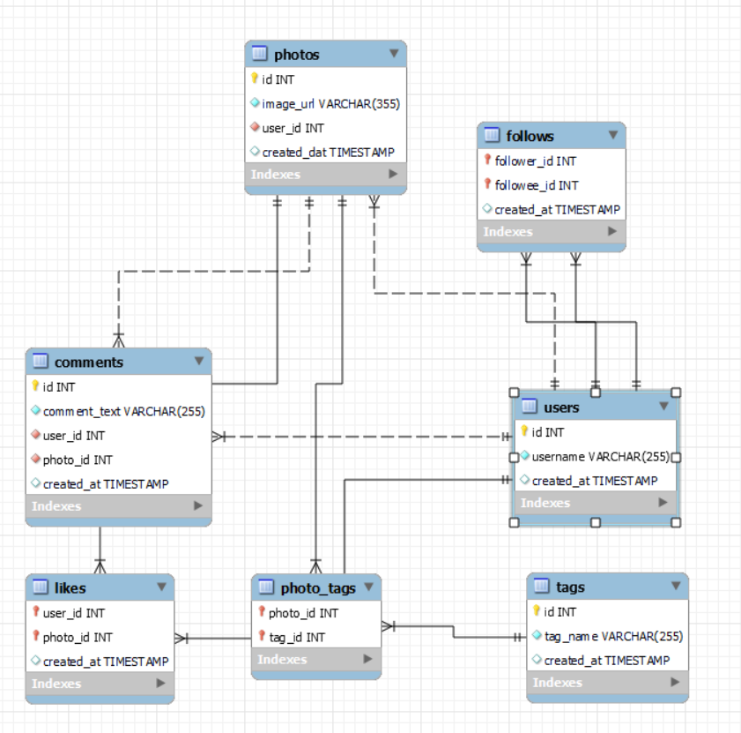
Data Schema

Slide 7
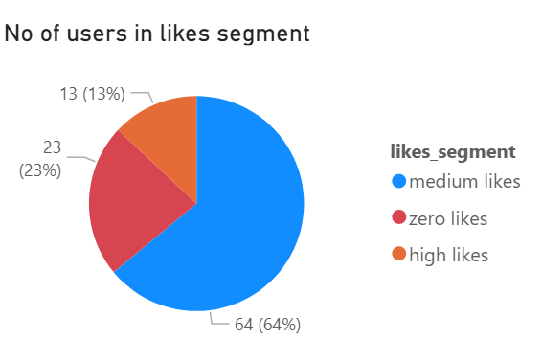
Distribution of User Activity(Likes)
Insights:
64% of users fall into the "medium likes" category, showing moderate engagement and potential for increased activity with the right nudges.
23% of users show zero likes, signaling passive behavior or disinterest, which may indicate weak content relevance or engagement strategy.
Recommendations:
Target "medium" users with engaging prompts or incentives (e.g., reactions, gamified features) to convert them into high-engagement users.
Investigate zero-like users’ behavior and experiment with personalized content or onboarding to reduce passive scrolling.

Slide 8
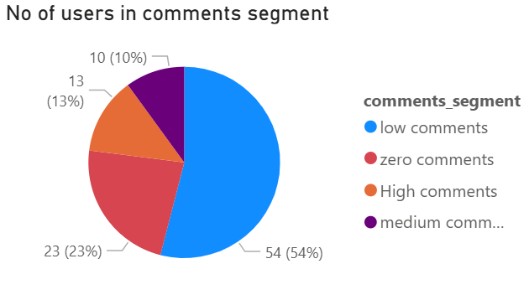
Distribution of User Activity(Comments)
Insights:
Over half the users(54%) have low comment activity, indicating they engage minimally by commenting on posts.
Nearly one-fourth of users do not comment at all, showing a large passive or lurker group that consumes content but does not engage actively through comments.
Only about 23% of users are actively commenting (medium or high), representing the core engaged community who drive conversations and interactions.
. Encourage Balanced Comment Participation
Introduce comment streak rewards to promote consistent engagement across multiple posts.
Notify users when their favorite creators post new content to prompt timely commenting.
Boost Comments on Low-Engagement Posts
Use AI to suggest posts with few comments in users’ feeds to drive balanced interaction.
Highlight “Be the first to comment!” badges for visibility and incentive.
comments

Slide 9
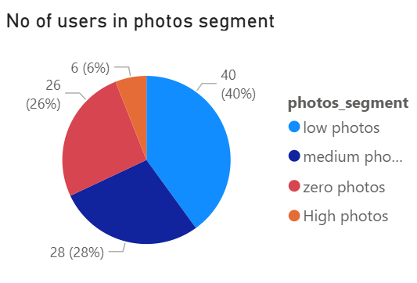
Distribution of User Activity(photos)
Insights:
The largest segment, with 40 users, falls into the "low photos" category, suggesting a significant portion of users are lightly active in terms of photo uploads.
The second-largest group, 28 users, belongs to the "medium photos" segment.
A notable 26% (26 users) have posted zero photos. This is a sizable inactive user group in terms of photo content contribution.
The smallest segment, only 6 users (6%), are a minority of highly engaged users who contribute most of the photo content.
Recommendations:
Focus on campaigns or features that encourage photo sharing, such as challenges, rewards, or easy-to-use photo upload tools. Monitor Segment Shifts Over Time.
For zero and low photo users, conduct surveys or analyze user behavior to understand why they are not posting photos—possible issues could be privacy concerns, usability, or lack of motivation.

Slide 10
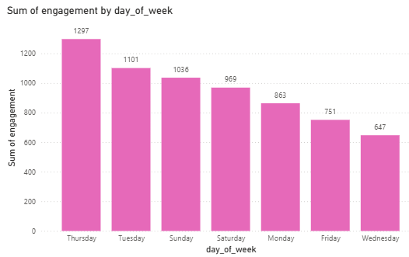
Peak engagement day
Insights:
Thursdays and Tuesdays emerged as the days with the highest engagement on posts, suggesting these are the most active days for user interaction.
Wednesdays showed the lowest engagement, indicating reduced user activity and interaction with content on this day.
Recommendations:
Encourage content scheduling on peak days (Thursday and Tuesday) to capitalize on higher user engagement and improve post reach.
Educate users and marketing teams about daily engagement trends to help them plan more effective posting strategies, avoiding low-performing days like Wednesday.

Slide 11
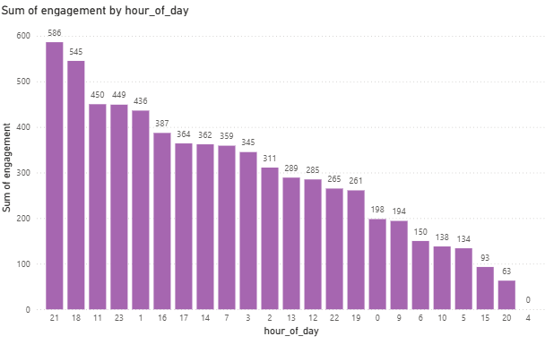
Peak engagement time
Insights:
The highest engagement is observed at 21:00 (586 engagements), followed by 18:00 (545).
Engagement remains high between 11:00 to 23:00, indicating strong activity during late mornings through late evenings.
Engagement significantly drops from midnight (0:00) to 10:00, with the lowest point at 4:00.Early morning and mid-afternoon are less optimal for user activity.
Recommendations:
Optimize content delivery by posting between 18:00 and 23:00, with 21:00 as the prime time.This timing increases the likelihood of visibility and engagement.
Avoid Low-Performing Hours
Minimize or avoid scheduling posts between 2:00 and 10:00, especially 4:00, when engagement is almost nonexistent.

Slide 12
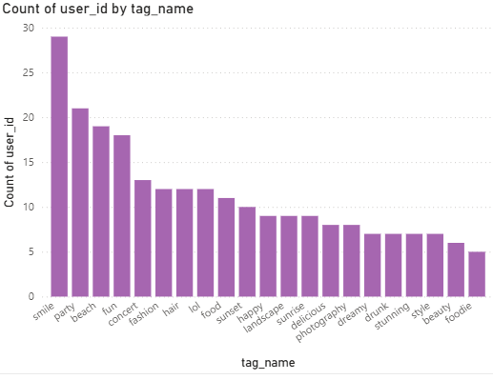
Top used tags
Insights
smile is the most widely used tag, with a clear lead,Other top-used tags
include party, beach, fun, and concert.
These tags suggest a strong preference for positive, social, and
leisure-oriented content.
Tags such as sunrise, landscape, delicious, photography, and dreamy
have lower usage.
Recommendations
Focus campaigns around smile, party, and fun to align with existing user
interests and drive visibility.
These tags resonate with emotional positivity and social engagement, ideal
for high interaction content.
Encourage users and content creators to mix trending tags with emerging
ones for wider reach and organic engagement boosts.

Slide 13
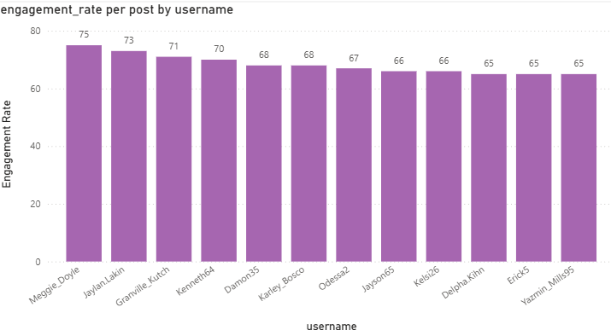
User segmentation
Insights:
Users like Meggie_Doyle and Jaylan.Lakin have the highest engagement rates, indicating they are strong influencers or highly effective content creators.
Engagement rates are relatively close among the top users, suggesting a consistently high-performing user base.
Recommendations
Prioritize collaboration or amplification through top performers like Meggie_Doyle to maximize reach and impact.
Encourage and support mid-tier users (65–70 range) with tools or incentives to push them into the top-performing bracket.

Slide 14
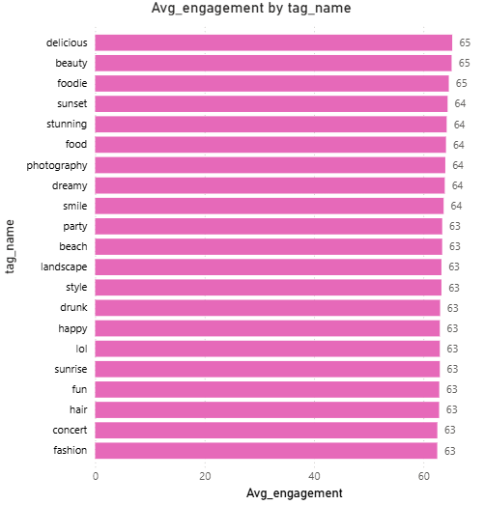
Top Engaging Tags
Insights:
Tags like delicious, beauty, and foodie have the highest average engagement, indicating strong audience interest in lifestyle and visually appealing content.
Emotional and aesthetic tags such as smile, happy, and sunset consistently perform well, showing that users engage more with positive and visually rich themes.
Recommendations:
Prioritize high-performing tags like delicious, beauty, and foodie in posts to boost likes, comments, and shares.
Combine emotional and visual tags (e.g., smile + sunset) to create relatable and engaging content that resonates widely.

Slide 15
Strategic Recommendations
Loyalty & Recognition Programs
Implement tiered badges (e.g., “Top Contributor,” “Community Champion”) to reward active users.
Offer exclusive early access to new features and beta rollouts for frequent users.
Personalized & Targeted Campaigns
Use tag-based segmentation for personalized ads based on users’ favorite hashtags (e.g., #smile, #delicious).
Create lookalike audiences from top-tag users for paid campaigns.
Influencer & Top User Engagement
Partner with top influencers (e.g., Karley_Bosco, Kenneth64) for niche content and long-term brand ambassadorships.
Involve high-engagement users in exclusive beta testing and campaigns.
Content & Posting Optimization
Encourage posting on high engagement days (Tuesdays and Thursdays) and times (6 PM to 11 PM, peak at 9 PM).
Educate users on best practices: hashtags, posting time, and content style for better reach.

Slide 16
Thank You

